Slide 1

Online Banking System
John Lee & Ravi Gupta

Slide 2
Requirements
The main goal for our project is to manage an online banking for add/remove customers, add/remove employees, add/change beneficiary, being able to check balance, transfering funds from one account to another account in the same bank, request for cheque books, request for statements summary. This online banking will let customers securely access to the bank website for viewing their account details and perform the transactions on their account as needed.

Slide 3
Cont.
Our objective is to provide these possible online services to the following customers that already has an account associated with our bank:
Will have access to login to our online website.
Customers can view their account details.
Customers will be able to transfer their funds to another person account associated with our bank.
Viewing/obtaining account statements
View balance enquiry.
Request for cheque books.
Adding Beneficiary added by the customer

Slide 4
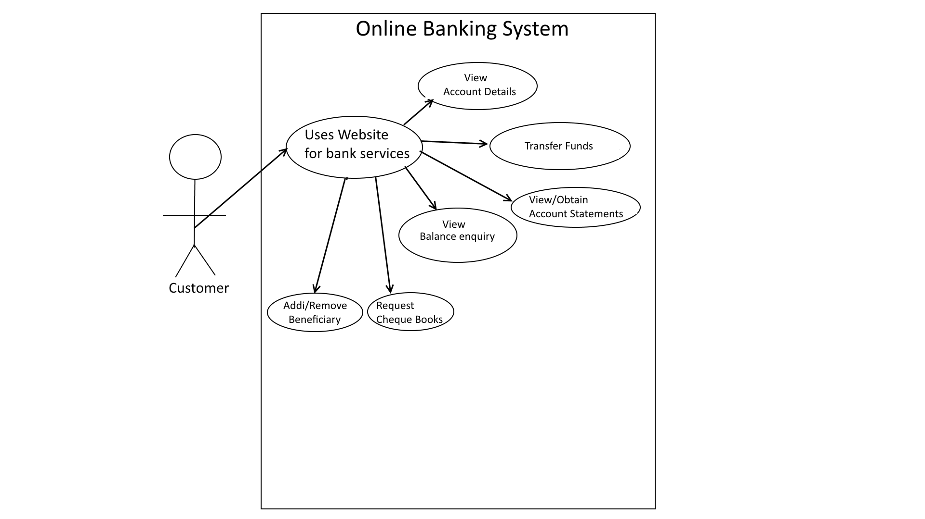

Slide 5
Software Requirements
We are using the following software to develop and create our project:
XAMPP 5.6.32
Apache 2.4.3
MYSQL 5.5
Operating System Windows 7 or higher

Slide 6
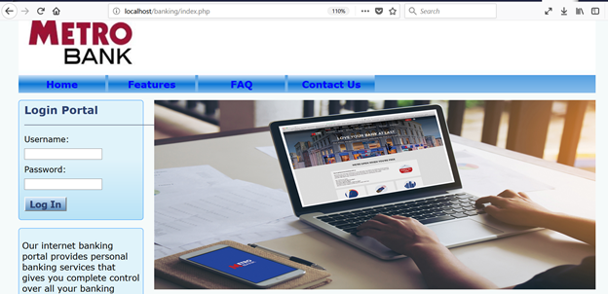
Website Interface

Slide 7
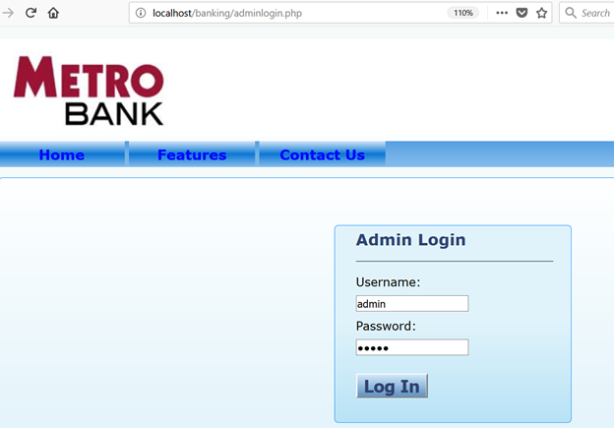
Admin Login

Slide 8
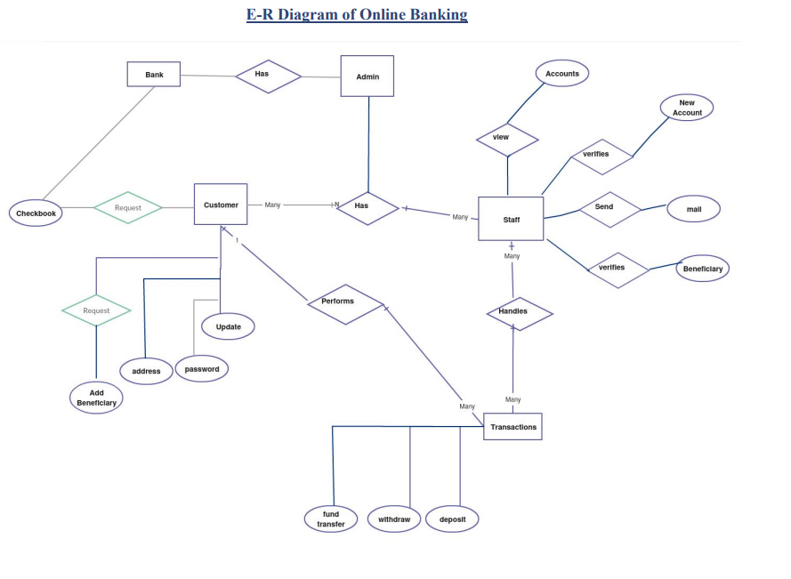

Slide 9
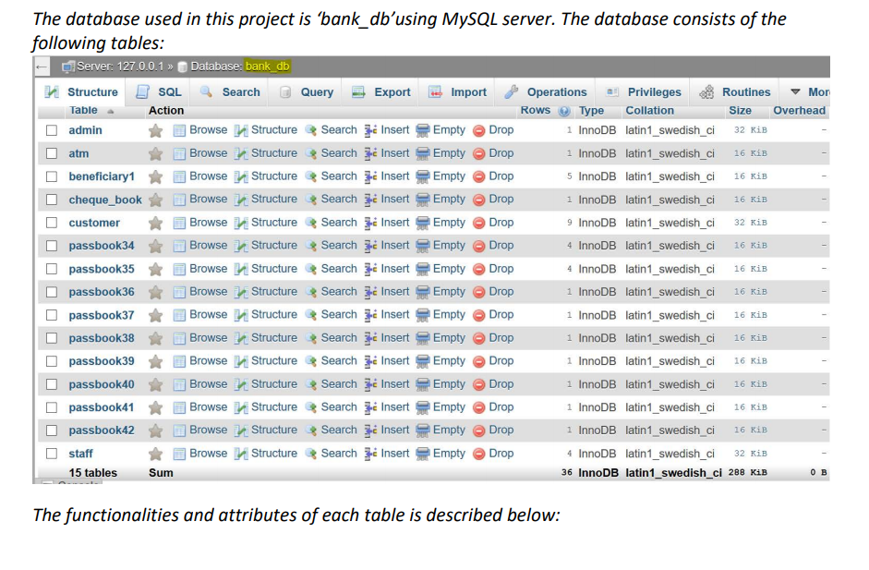

Slide 10
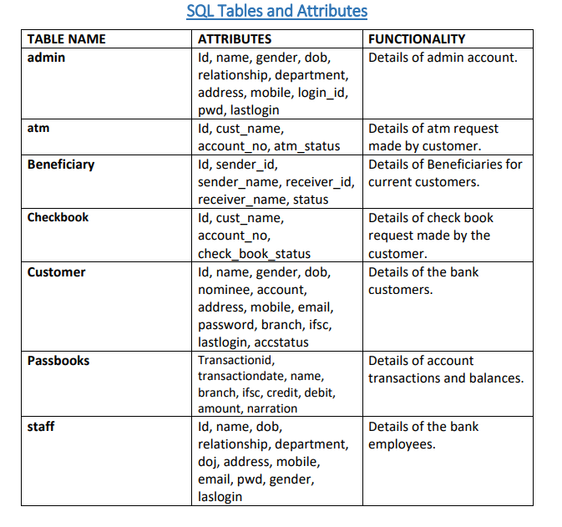
SQL TABLES and Attributes

